Slide 1
Fibonacci Heaps

Slide 2
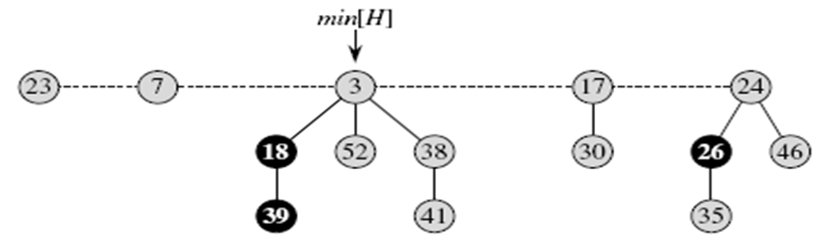
Fibonacci Heaps
Like a binomial heap, a Fibonacci heap is a collection of min-heap-ordered trees.
The trees in a Fibonacci heap are not constrained to be binomial trees.
Unlike trees within binomial heaps, which are ordered, trees within Fibonacci heaps are rooted but unordered.

Slide 3
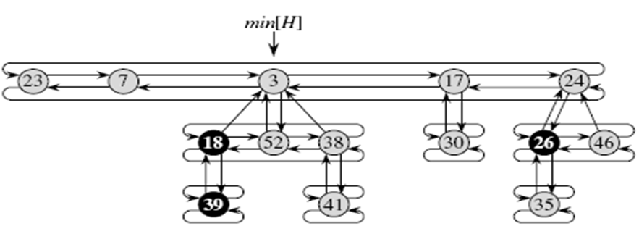
Fibonacci Heaps
each node x contains a pointer p[x] to its parent and a pointer child[x] to any one of its children.
The children of x are linked together in a circular, doubly linked list, which we call the child list of x.
Each child y in a child list has pointers left[y] and right[y] that point to y’s left and right siblings, respectively.

Slide 4
Fibonacci Heaps
If node y is an only child, then left[y] = right[y] = y.
The order in which siblings appear in a child list is arbitrary.
The number of children in the child list of node x is stored in degree[x].
The boolean-valued field mark[x] indicates whether node x has lost a child since the last time x was made the child of another node.
Newly created nodes are unmarked, and a node x becomes unmarked whenever it is made the child of another node.
A given Fibonacci heap H is accessed by a pointer min[H] to the root of a tree containing a minimum key; this node is called the minimum node of the Fibonacci heap.
If a Fibonacci heap H is empty, then min[H] = NIL.
The roots of all the trees in a Fibonacci heap are linked together using their left and right pointers into a circular, doubly linked list called the root list of the Fibonacci heap.

Slide 5
Fibonacci Heaps: Structure of a node
Each node x stores
  key[x]
  degree[x] (also rank(x))
  mark[x]
  p[x]
  child[x]
  left[x]
  right [x]
(4 pointers per node)
parent
key, degree
10
1
mark
FALSE
left
right
child

Slide 6
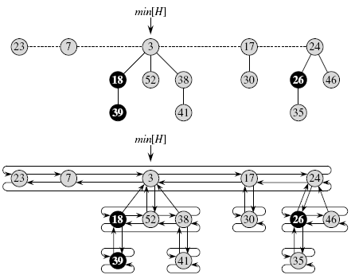
Fibonacci Heaps: Example

Slide 7
Fibonacci Heaps: Advantage of Circular, doubly linked list
Circular, doubly linked lists have two dvantages for use in Fibonacci heaps.
First, we can remove a node from a circular, doubly linked list in O(1) time.
Second, given two such lists, we can concatenate them (or “splice” them together) into one circular, doubly linked list in O(1) time.

Slide 8
Properties and Potential Function
Properties of FIB-HEAP H:
  Mark(x) = TRUE (marked, black in slide),
  FALSE (yellow in slide)
  n[H] = number of nodes in H
  t(H) = number of trees in H
  m(H) = number of marked notes in H
Potential Function for Amortized Analysis
  Φ(H) = t(H) + 2 m(H) .
min[H]
7
24
23
17
3
n[H] = 14
t(H) = 5
m(H) = 3
30
26
46
18
52
41
35
44
H
39
Notes:
sequence -> ordered

Slide 9
Maximum Degree
There is a upper bound D(n) on the maximum degree of any node in an n-node Fibonacci heap. D(n) ≤ lg n Why?

Slide 10
Reason
Each Fibonacci heap is simply a collection of “unordered” binomial trees. An unordered binomial tree is like a binomial tree, and it, too, is defined recursively. The unordered binomial tree U0 consists of a single node, and an unordered binomial tree Uk consists of two unordered binomial trees Uk−1 for which the root of one is made into any child of the root of the other. For the unordered binomial tree Uk , the root has degree k, which is greater than that of any other node. The children of the root are roots of subtrees U0,U1, . . . ,Uk−1 in some order. Thus, if an n-node Fibonacci heap is a collection of unordered binomial trees, then D(n) = lg n.

Slide 11
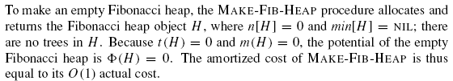
Creating a new Fibonacci heap

Slide 12
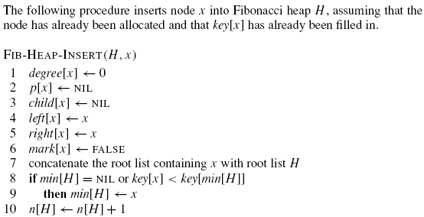
Inserting a node

Slide 13
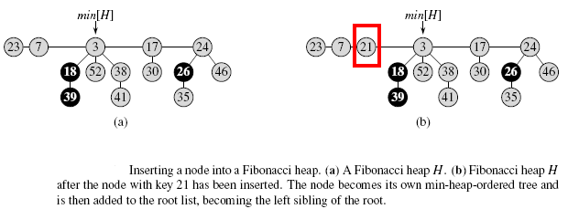
Inserting a node: Example

Slide 14
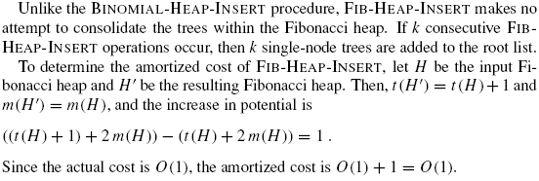
Insertion Analysis

Slide 15
Finding the minimum node
The minimum node of a Fibonacci heap H is given by the pointer min[H], so we can find the minimum node in O(1) actual time.
Because the potential of H does not change, the amortized cost of this operation is equal to its O(1) actual cost.

Slide 16

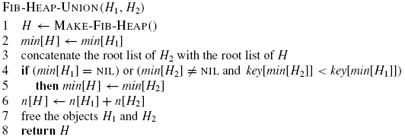
Uniting two Fibonacci heaps

Slide 17
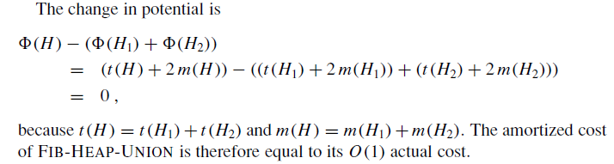
Cost of Union

Slide 18
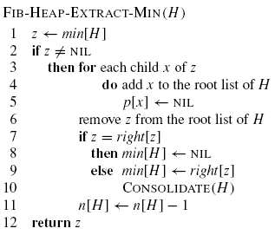
Extracting the minimum node

Slide 19
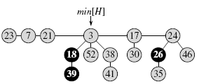
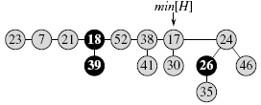
Extracting the minimum node

Slide 20
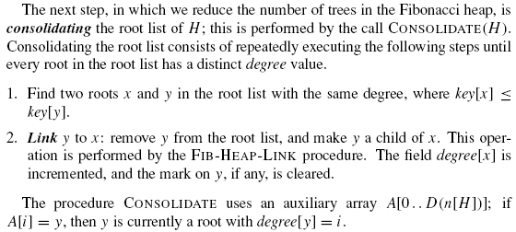
Consolidation

Slide 21
Linking Step
FIB-HEAP-LINK (H, y, x)
Linking step
x
y
x
y
Assume x ≤ y
FIB-HEAP-LINK (H, y, x) ⊳ Assume x ≤ y
  remove y from the root list of H
  make y a child of x, incrementing degree[x]
  mark[y] ← FALSE
Constant time O(1)

Slide 22
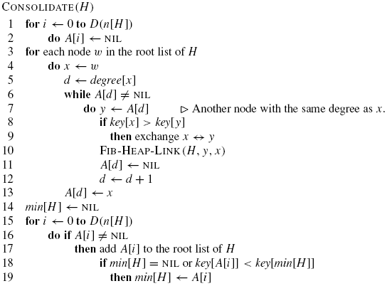
Algorithm for Consolidation

Slide 23
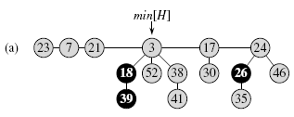
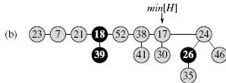
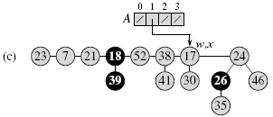
Consolidation: Example

Slide 24
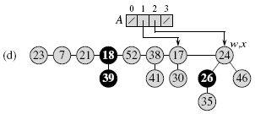
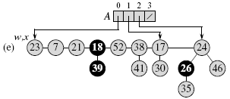
Consolidation: Example

Slide 25
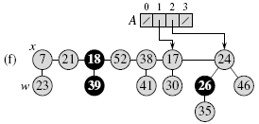
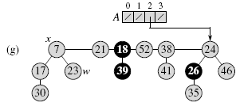
Consolidation: Example

Slide 26
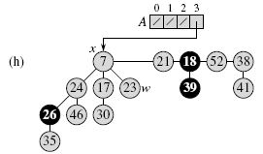
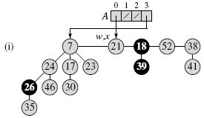
Consolidation: Example

Slide 27
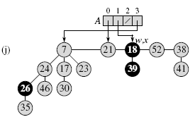
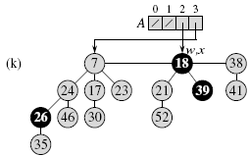
Consolidation: Example

Slide 28
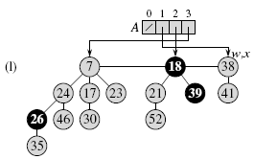
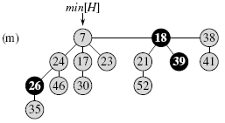
Consolidation: Example

Slide 29

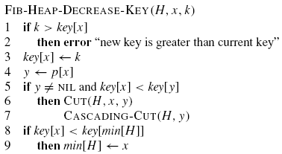
Decreasing a key

Slide 30
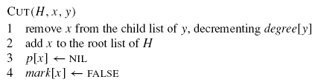
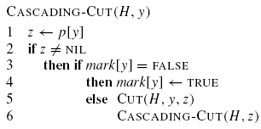
Decreasing a key

Slide 31
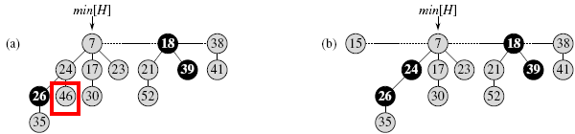
Decreasing a key: Example
The initial Fibonacci heap.
The node with key 46 has its key decreased to 15. The node becomes a root, and its parent (with key 24), which had previously been unmarked, becomes marked.

Slide 32
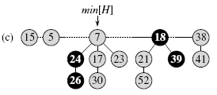
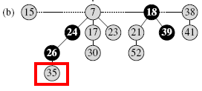
Decreasing a key: Example
(b)The initial Fibonacci heap.
(c) The node with key 35 has its key decreased to 5.

Slide 33
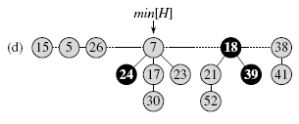
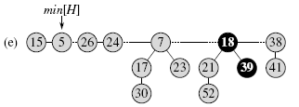
Decreasing a key: Example

Slide 34
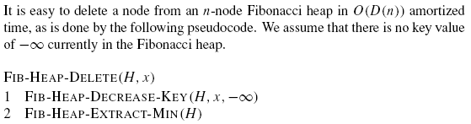
Deleting a node

Slide 35
Fibonacci Heaps (Summary)
MINIMUM(H) O(1)
UNION(H₁, H₂) O(1)
INSERT(H, x) O(1)
EXTRACT-MIN(H) O(lg n)*
DECREASE-KEY (H, x, k) O(1)*
DELETE (H, x) O(lg n)*

